Slide 1
Workshop on Arduino Microcontroller Programming & Interfacing
9-10-11 October 2015

Slide 2
Objectives…
It is presumed that a Tinkerer would like to build an interactive system – a cool project which would do something novel!
It is a done thing that we need to put some kind of microcontroller chip to do all the work
It is necessary to learn about connecting and programming a chip with minimal fuss. So we decide to use Arduino hardware & software in our projects and hence the goals are:-

Slide 3
Goals…
To learn about Arduino hardware from the input/output perspective without going in the details of the chip’s architecture and machine language.
To learn programming in a higher level language than C – Lot more simplified for novices who wish to achieve a given goal quickly.

Slide 4
At the end of this workshop, you will be conversant about …
Simple digital input and output
Simple analog input
Analog output using a PWM
Interfacing switches, LEDs, buzzer, potentiometer and LCD display.
Serial Communication with PC
Writing some code in C which will make use of all these interfaces and create a simple application.

Slide 5
What’s so great about Arduino?
It uses ATMEL AVR series MCU which are excellent low cost low power RISC machines with 1 MIPS output per MHz.
It has built in multi-channel ADC for analog inputs and several PWM channels for analog outputs.
The MCU ICs and the board are easily available in INDIA at lowest prices.

Slide 6
What’s so great about Arduino?
IT IS AN OPEN SOURCE PLATFORM !!!!
which means everything about it is freely available on internet, can be shared, modified and enjoyed worldwide.
You are encouraged to improve it and share with others
A large number of well-wishers are available to help you all over the world.

Slide 7
What’s so great about Arduino?
IT IS AN OPEN SOURCE PLATFORM !!!!
Nobody owns it and everybody owns it so there is no price of intellectual property.

Slide 8
Let’s Start with ARDUINO..
For all matters related to Arduino always refer to the main website
http://www.arduino.cc/

Slide 9
What is Arduino?
Arduino is an open-source electronics prototyping platform based on flexible, easy-to-use hardware and software. It's intended for artists, designers, hobbyists, and anyone interested in creating interactive objects or environments.

Slide 10
What is Arduino?
Arduino can sense the environment by receiving input from a variety of sensors and can affect its surroundings by controlling lights, motors, and other actuators.

Slide 11
What is Arduino?
Arduino is actually 3 things:
An IDE (based on Processing) software which uses Arduino Programming language (based on Wiring), similar to C/C++and lot simpler.
One or more hardware boards with some common interface standards so that programs developed for one can run on another easily
Bootloader code or firmware which is expected to be resident in chips used in Arduino boards

Slide 12
Little bit of History…
See full history for various names on
https://en.wikipedia.org/wiki/Arduino#History
http://www.circuitstoday.com/story-and-history-of-development-of-arduino
http://www.freeduino.org/duino.html

Slide 13
Little bit of History…
1100A.D.
Arduin of Italy: the name of an ancient Italian king. Circa 1100 AD.
1100A.D.- 2004A.D.
No microcontrollers named after King Arduin for about 900 years. It took a while for this to catch on.
2005- 2007
Arduino: the name of the bar where the Arduino team cooked up their original plan for the Arduino microcontroller, circa summer 2005.
Boarduino: ladyada's standalone Arduino-compatible, circa early 2007.
Freeduino: our contribution, born September 2007.
Uduino: an early one from back in 2007.

Slide 14
The Original Makers of Arduino..
Development team
The core Arduino developer team is composed of Massimo Banzi, David Cuartielles, Tom Igoe, Gianluca Martino, David Mellis and Nicholas Zambetti.

Slide 15
Where to buy Arduino hardware?
List of Vendors in India who sell Microcontroller Boards and Robotics Parts:
www.Robokits.co.in
www.sunrom.com
www.bhashatech.cc
www.Embeddedmarket.com
www.robosoftsystems.co.in
http://www.nex-robotics.com/
http://www.rhydolabz.com/
http://www.thinklabs.in/
www.Onlinetps.com
http://www.pantechsolutions.net/
http://vegarobokit.com/default.aspx
http://build.simplelabs.co.in/content/simple-labs-webshop
http://tenettech.com/
http://stores.ebay.com/AVRMEGASHOP
www.technido.com
And many more in our country….

Slide 16
What is Arduino Software?
The Arduino IDE is a cross-platform application written in Java which is derived from the IDE made for the Processing programming language and the Wiring project. It is designed to introduce programming to artists and other newcomers unfamiliar with software development.

Slide 17
What is Arduino Software?
It includes a code editor with features such as syntax highlighting, brace matching, and automatic indentation, and is also capable of compiling and uploading programs to the board with a single click. There is typically no need to edit Makefiles or run programs on the command line.

Slide 18
What is Arduino Software?
The Arduino IDE comes with a C / C++ library called "Wiring" (from the project of the same name), which makes many common input/output operations much easier. Arduino programs are written in C/C++, although users only need to define two functions in order to make a runnable program:

Slide 19
What is Arduino Software?
Only two functions are needed to make a minimal program or sketch:
setup() – a function run once at the start of a program which can be used for initializing settings, and
loop() – a function called repeatedly until the board is powered off.

Slide 20
A Typical First Program…
A typical first program for a microcontroller is to simply blink a LED on and off. In the Arduino environment, the user might write a program like this:

Slide 21
Setup function
//Code Starts here
int ledPin = 13; // LED connected to digital pin 13
// The setup() method runs once, when the sketch starts
void setup()
{
// initialize the digital pin as an output:
pinMode(ledPin, OUTPUT);
}
*debug LED – already on board!

Slide 22
Loop function
// the loop() method runs over and over again,
// as long as the Arduino has power
void loop()
{
digitalWrite(ledPin, HIGH); // set the LED on
delay(1000); // wait for a second
digitalWrite(ledPin, LOW); // set the LED off
delay(1000); // wait for a second
}
//Code Ends here

Slide 23
What is Arduino Software?
The above code would not be seen by a standard C++ compiler as a valid program, so when the user clicks the "Upload” button in the IDE, a copy of the code is written to a temporary file with an extra include header at the top and a very simple main() function at the bottom, to make it a valid C++ program.

Slide 24
Advantages Of Arduino Software..
Since the IDE is pin oriented, we can quickly achieve our desired logic and build a working model.
At a later stage we can always add more complex functions in C, without disturbing the Arduino framework.

Slide 25
Getting Acquainted with Your Hardware
All of us here have a Arduino Uno Board with USB interface.
This board can be powered by laptop +5V supply which is given through USB cable.
It can be powered by 8V to 12V DC supply which converts it into 5V and 3.3V
However, when we use high voltage / current drawing devices like LCD display & Motor etc, we will use 12V power supply.

Slide 26
Getting Acquainted with Your Hardware
Your Arduino board has 28-pin DIP MCU chip called ATmega328. It has :-
32K Bytes ROM for program storage
2K Bytes RAM for data storage
1K Bytes EEPROM for constants
Number of Input /Output Lines
14 Digital I/O
6 Analog Input

Slide 27
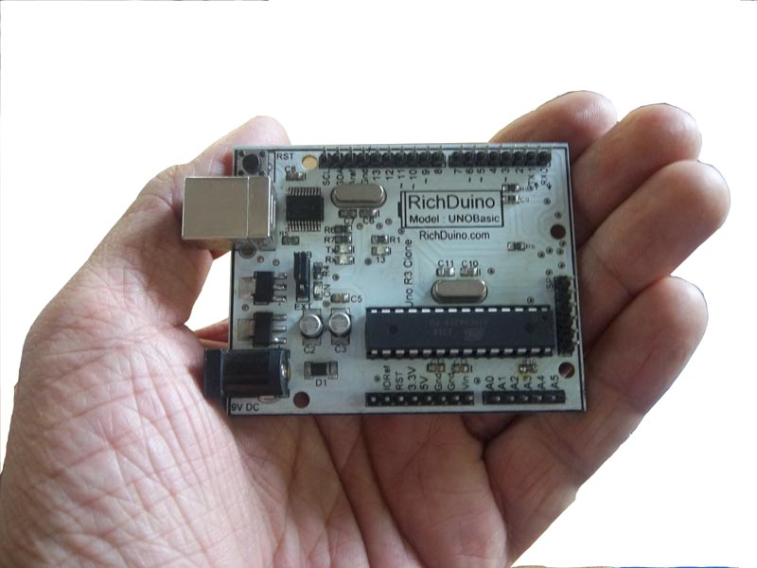
Meet a clone ..Richduino Unobasic
Note:
USB Connector
Power Connector
Digital Pins
Analog Pins
MCU chip
Crystal
ICSP programmer
Debug LED
Tx & Rx LEDs

Slide 28
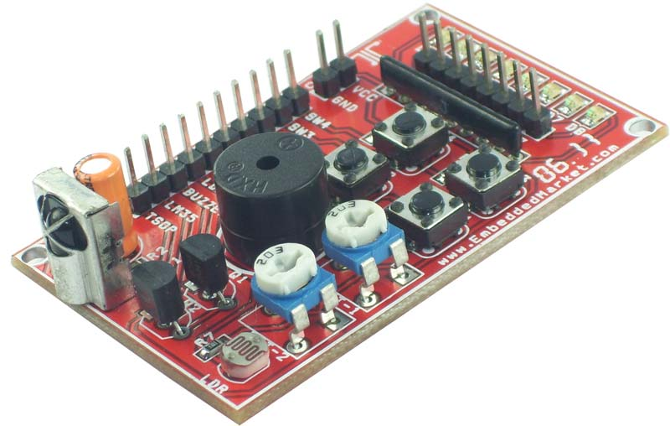
Analog & Digital Iinput Output Board from Technido
The board contains:
8 LEDs
4 Switches
2 Potentiometers
1 Buzzer
1 LDR
1 TSOP Infrared Receiver
1 LM35D temp Sensor
LCD Display
Common 5V and GND

Slide 29
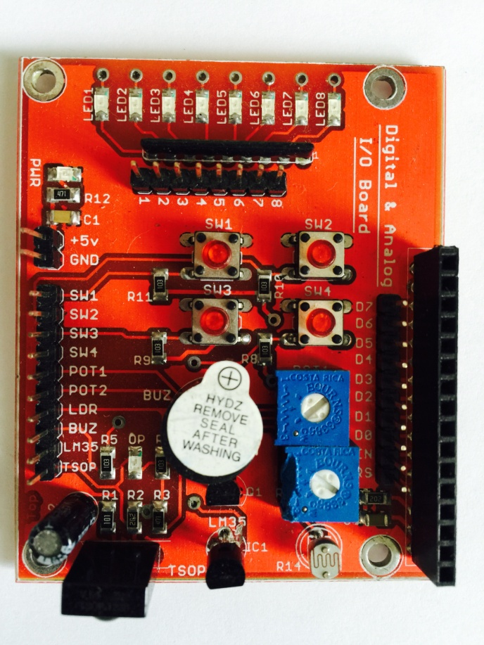
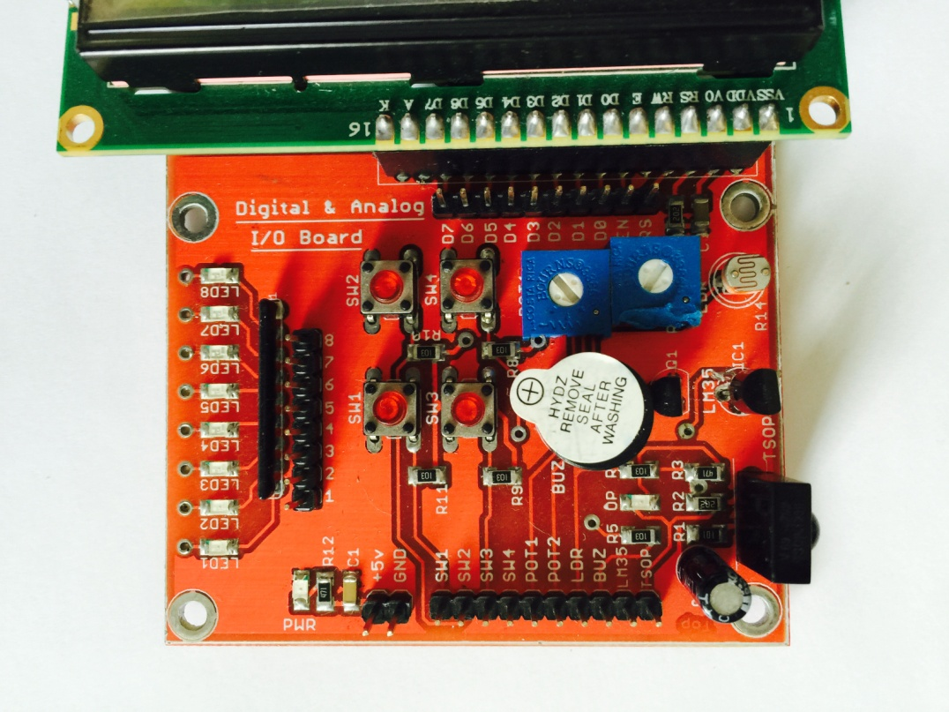
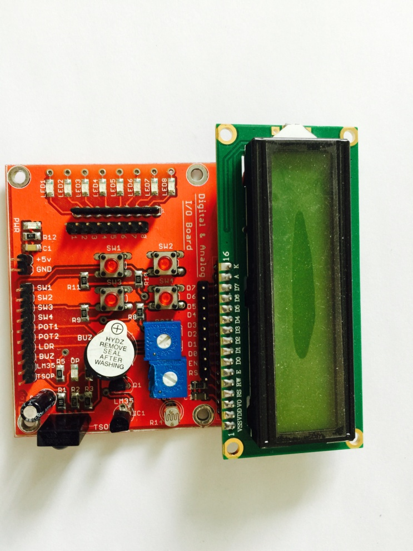

Slide 30
Connection between Arduino & GPIO Board
Connect 5V of Arduino to VCC pin of GPIO Board.
Connect GND of Arduino to GND pin of GPIO Board.
Connect wires as mentioned in any sketch.
You would generally use few switches, few LEDs , 1 or 2 potentiometers, buzzer, TSOP TV Remote IR receiver, LM35 Temperature Sensor and LDR light sensor

Slide 31
Communication with PC
Arduino boards can communicate with PC or Host Machine through USB –to-Serial Communication
They can communicate with each other using standard TTL UART communication ports, either in hardware or software implemented

Slide 32
What is essential to make your board Arduino compatible?
Anybody is free to make a board but he must provide following onboard facilities:
9-12V unregulated input to 5V output power supply.( current <500 mA)
Programming interface –Serial or USB for uploading application code
SPI interface to burn boot loader code in a fresh blank MCU.(ICSP connector)
Input output Pins brought out on connectors as specified. (Dimensions specified)
Clock crystal 16MHz.

Slide 33
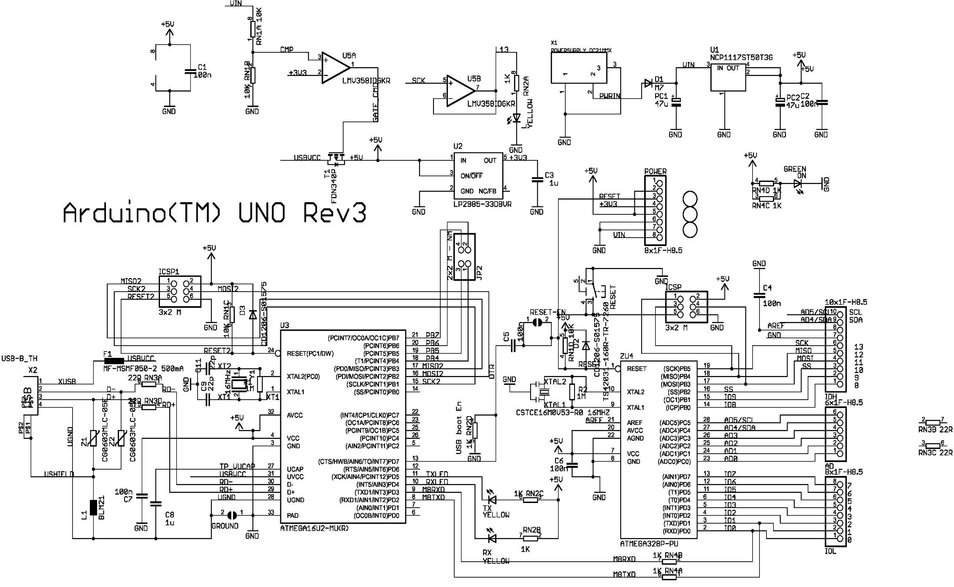
Schematic of Arduino Uno Board

Slide 34
Let us Enjoy the Programming Now…
Please click on the shortcut on your desktop to start Arduino IDE. The current version is 1.6.3
Please follow as I do on my PC
We will go slow until everybody in the class has got it right.
Please raise your hand to seek help.

Slide 35
ARDUINO IDE Commands (Buttons)
When you switch on IDE, the screen will open a new file for you to create and store your sketch or program. The file name will change every time depending upon the date of the computer so do not worry. It is a help.
Now it shows sketch_oct10a | arduino 1.6.3

Slide 36
ARDUINO IDE Commands (Buttons)
You see 5 button in top left line. They are:
VERIFY – To compile your sketch/program
UPLOAD – To transfer machine code in board
NEW – To create a new sketch / program
OPEN – To open a sketch already stored
SAVE – To save modification in sketch

Slide 37
ARDUINO IDE Commands (Buttons)
You see some Menu button on top left side.
FILE –
EDIT –
SKETCH–
TOOLS –
HELP –
We will not worry what they all mean now but learn about them as we need……

Slide 38
ARDUINO IDE Examples
Arduino is famous for its pre-formed or tested sample sketches or programs to help us as starting point.
These are clubbed under
File -> Examples
They are grouped in 27 categories for easy understanding. We will use Basics, Digital, Analog, Communications and Liquid Crystal. We have added IRremote.

Slide 39
Select Arduino Board & Port used…
Let us say we wish run a sketch from Examples:
File -> Examples->Basics->Blink
This will open original Blink sketch in a new window. We will work in that window now. Do not bother about old window.
Now select the board and programming port using Tools-> Board -> ARDUINO UNO. This will select our board.

Slide 40
Select Arduino Board & Port used…
Now select the programming interface.
If board is connected AND device driver is installed and a name to serial port is given as such as COMnn, select it.
Select Tools-> Port-> COMnn This will select virtual serial port created by USB to Serial Driver.

Slide 41
A Typical Sketch Development
8. Press VERIFY Button. Bottom right shows progress bar.
9. Bottom left line shows Compiling Sketch… and after some time as Done Compiling. Now IDE has created machine code file for us and it is ready to send it to Board.
10. If there were any compilation errors they will be highlighted in red at the bottom of the screen.

Slide 42
A Typical Sketch Development
11. UPLOAD button on top left, performs dual tasks of compilation as well as transportation of machine code to the board. When we press UPLOAD button, the IDE bottom line shows first Compiling Sketch and then Uploading….
If some issue then above message remains there for quite some time and then an error message in red colour on black background appears the left bottom.

Slide 43
A Typical Sketch Development
12. If the board is connected and powered, the uploading will begin in 2-3 seconds. The Debug LED as well as Tx and Rx LEDs on board will blink on the board indicating that machine code file is being transferred from PC to board. The time it takes depends upon length of program but it is usually 2 to 10 seconds.

Slide 44
A Typical Sketch Development
13. If successful then a message Done Uploading. appears. (It means that machine code is now stored in non-volatile or flash memory or ROM of the MCU and can be run again and again without downloading.)
14. After this the MCU on board is reset by PC. MCU takes about 1 to 2 seconds and then runs our program or sketch.
15. To rerun any program already stored in flash memory, we need to press RESET button on board.
16. If a program in ROM is corrupted for some reason then we can redo all steps and load fresh machine code in board and run the code.

Slide 45
Another Typical Sketch Development
Let us say we wish to create a new program or sketch
File -> New This will opens another similar window with same name.
Save it under a new filename say my_program.
File -> Save As. A new window will open.Select appropriate folder and appropriate filename like my_program. The window at the top will now show filename as my_program rather than sketch06a.
Type your code here. Occasionally press keys CTRL-S or SAVE button on IDE.
Once done, verify and upload.

Slide 46
PRACTICAL
Let us now start working on the first program.
Make sure that your desktop has folder called
“Sketches For IITB Workshop”.
3. Open spreadsheet “List Of Sketches for Woekshop on 9 10 11 Oct 2015.xlsx”.
It will guide us the sequence in which we need to run the sketches.

Slide 47
Sequence of Learning…
Digital Output & Input
Analog Output & Input
LCD Interfacing
Serial Interface
Motor Control
TV Remote
Sensor reading

Slide 48
1. Digital Output & Input

Slide 49
Digital Output Mode Setting
Like all other MCUs, Arduino MCU digital I/O port pins are bi-directional and we can set them as input or output as desired. This has to be to be done once so we usually write this command in setup function.
The command set up port pin direction is
pinMode (pin_no, OUTPUT); to set in output mode or
pinMode (pin_no, INPUT); to set in output mode.

Slide 50
Digital Output
Let us begin with Digital Output through sketches.
My_blink
My_blink_buzzer
We will use LED connected to pin 13 on Arduino Board. Connect Arduino pin 12 to pin marked BUZZER on GPIO board. Ensure 5V and GND on GPIO are connected properly to 5V and 0V on Arduino.

Slide 51
Digital Output Command
The command sets logic level on a digital output pin
digitalWrite(pin_no, integer d);
where pin_no = any pin 0 to 13 and
d = constant HIGH or LOW (note syntax)
Rarely analog input pins can also be made to behave like digital pins and then they are labeled as A0 to A5.

Slide 52
Digital Input
Let us now work with Digital Input through sketches.
My_button
Switch_transition
We will use switch marked SW4 on GPIO board and connect pin SW4 to Arduino pin 7 as directed. Please note that 5V and GND wires are always required to be connected.

Slide 53
Digital Input Command
The command to read the voltage level on any digital input is
int value = digitalRead(pin_no);
where value = 1 for 5V and 0 for GND and pin_no = any pin 0 to 13
Rarely analog input pins can also be made to behave like digital pins and then they are labeled as A0 to A5.

Slide 54
2. Analog Output & Input

Slide 55
Analog Output using PWM
PWM stands for Pulse width Modulation.
In PWM, MCU generates a medium frequency ( 1 to 10 KHz) pulse train whose time period is fixed but its duty cycle varies.
Duty cycle can be varied from 0 to 100%
If we integrate this wave then average voltage of the wave is
v = V * on_time /( total time)

Slide 56
Analog Output using PWM
The command to generate variable duty cycle PWM output on pin number pin_no is :
analogWrite(pin_no, integer d);
d can be any value from 0 to 255
d = 0 means output value v = 0
d = 255 means output value v = 100%

Slide 57
Analog Output using PWM
In Arduino V is TTL voltage which is nearly 5V.
Thus by selecting appropriate value of d, we can get a analog value 0 to 5V on PWM pin.
However, to get that we need an integrator which will convert these pulses into smooth dc voltage.
Integrator can be constructed using external R-C components or it can be done by load itself such as inductive nature of DC motor coil.

Slide 58
Analog Output using PWM
Examples:
analogWrite(9,0);// output voltage = 0V
analogWrite(9,64);// output voltage = 1.25V
analogWrite(9,128);// output voltage = 2.5V
analogWrite(9,192);// output voltage = 3.75V
analogWrite(9,255);// output voltage = 5V

Slide 59
Analog Output Connections & Sketches
Let us begin with Analog Output through sketch.
PWM_LED_Fading
We will use LED 0 on GPIO Board as output peripheral device and connect it to Arduino pin 9 PWM output as directed.
Do not use LED on Arduino board for this purpose as it is hardwired to pin 13. Using it will short pin 9 and pin 13.

Slide 60
LED on GPIO is Inverse of LED on Arduino
LED on Arduino board anode is connected to pin no 13 and cathode is connected to ground through a 1K resistor. It is called as ACTIVE HIGH i.e. when pin 13 is HIGH, LED is ON.
All 8 LEDs on GPIO board are ACTIVE LOW. Pins LED 0 to LED 7 are connected to cathode of respective LED and its anode is connected to 5V supply through a resistor. Thus when LOW is given to LED pin, it is ON.
Thus LED on GPIO board is “Inverse” of LED on Arduino.

Slide 61
Analog Input in Arduino
AVR MCU has 6 channels each with 10-bit resolution. That means it can have a value between 0 to 1023.
They are available through Analog pins 0 to 5.
Each channel can connect to independent analog input signal of voltage levels 0 to Aref.
Conversion time is in tens of microseconds.
Usually Aref is same as VCC or 5V.
The command to convert and read a channel is
int analog_value = analogRead(pin_no);

Slide 62
Analog Input in Arduino
If input voltage is 0V, analog_value = 0.
If input voltage is 5V, analog_value = 1023
If input voltage is 2.5V, analog_value = 512
If input voltage is 1.25V, analog_value = 256
If input voltage is 3.75V, analog_value = 768

Slide 63
Analog Input Connections & Sketches
Let us begin with Analog Input through sketch.
Analoginput_PWMoutput
Analoginput_LEDTiming
Read_Pots_LED_buzzer
We will use POT-1 and POT-2 on GPIO Board as analog value sources and connect it to Arduino analog pin 0 and 1 respectively. Use an aligner to adjust pot values from 0 to 5V.

Slide 64
3. Alphanumeric LCD Interfacing
(Human Output Interface)

Slide 65
LiquidCrystal Library
This library allows an Arduino board to control LiquidCrystal displays (LCDs) based on the Hitachi HD44780 (or a compatible) chipset, which is found on most text-based LCDs. The library works with in either 4- or 8-bit mode (i.e. using 4 or 8 data lines in addition to the RS, ENABLE and optionally, the R/W control lines).

Slide 66
LiquidCrystal Library Functions
LiquidCrystal() – Creates a variable of type LiquidCrystal.
begin()-specifies the dimensions (width and height) of the display.
clear() - Clears the LCD screen and positions the cursor in the upper-left corner.
home() -Positions the cursor in the upper-left of the LCD.
setCursor() -Position the LCD cursor;
write() - Write a character to the LCD.
print() -Prints text to the LCD.

Slide 67
LiquidCrystal Library Functions
cursor()-Display the LCD cursor: an underscore (line) at the position to which the next character will be written.
noCursor() - Hides the LCD cursor.
blink() - Display the blinking LCD cursor.
noBlink()- Turns off the blinking LCD cursor.
display() - Turns on the LCD display, after it's been turned off with noDisplay().
noDisplay() - Turns off the LCD display, without losing the text currently shown on it.

Slide 68
LiquidCrystal Library Functions
scrollDisplayLeft()-Scrolls the contents of the display (text and cursor) one space to the left.
scrollDisplayRight() -Scrolls the contents of the display (text and cursor) one space to the right.
autoscroll() - Turns on automatic scrolling of the LCD. This causes each character output to the display to push previous characters over by one space. If the current text direction is left-to-right (the default), the display scrolls to the left; if the current direction is right-to-left, the display scrolls to the right. This has the effect of outputting each new character to the same location on the LCD.

Slide 69
LiquidCrystal Library Functions
noAutoscroll()-Turns off automatic scrolling of the LCD.
leftToRight() -Set the direction for text written to the LCD to left-to-right, the default.
rightToLeft() - Set the direction for text written to the LCD to right-to-left (the default is left-to-right). This means that subsequent characters written to the display will go from right to left, but does not affect previously-output text.
createChar() - Create a custom character (gylph) for use on the LCD. Up to eight characters of 5x8 pixels are supported (numbered 0 to 7). The appearance of each custom character is specified by an array of eight bytes, one for each row. The five least significant bits of each byte determine the pixels in that row. To display a custom character on the screen, write() its number.

Slide 70
LiquidCrystal Library Examples
Hello World - displays "hello world!" and the seconds since reset
Blink - control of the block-style cursor
Cursor - control of the underscore-style cursor
Display - quickly blank the display without losing what's on it.
Text Direction - control which way text flows from the cursor
Autoscroll - automatically scroll new text
Serial input - accepts serial input, displays it
SetCursor - set the cursor position
Scroll - scroll text left and right

Slide 71
LCD Connections & Sketches
LCD has a huge library examples in Arduino. We will use a few as follows:
My_HelloWorld
Number_on_LCD
LCD is a separate unit with 16 pin connector. Check pin no. 1 marked on it. First disconnect USB cable to Arduino board so that it is powered down and then make connections as shown next.
!!Handle LCD carefully against static Electricity Damage!!

Slide 72
LCD to Arduino Connections
LCD MODULE TO ARDUIONO BOARD CONNECTIONS
LCD | LCD | ARDUINO | ARDUINO
SIGNAL NAME | PIN NO. | PIN NO | SIGNAL NAME
Ground | 1 | GND | Ground
+5V | 2 | +5V | Power
Contrast (GND) | 3
Register Select R/S | 4 | 11 | Digital 11
Read/write\ (GND) | 5
Enable | 6 | 10 | Digital 10
Data 0 | 7
Data 1 | 8
Data 2 | 9
Data 3 | 10
Data 4 | 11 | 5 | Digital 5
Data 5 | 12 | 4 | Digital 4
Data 6 | 13 | 3 | Digital 3
Data 7 | 14 | 2 | Digital 2
LED -ve (GND) | 15
LED +ve (+5V) | 16
Note: 1. Connect only 8 wires shown above.
2. Rest of 5V and Ground are internally shorted on LCD module.
:

Slide 73
4. Serial Programming
(Communicating with PC and other MCUs)

Slide 74
Serial Communication through UART Commands
This library is used for communication between the Arduino board and a computer or other devices. All Arduino boards have at least one serial port (also known as a UART or USART): Serial.
It communicates on digital pins 0 (RX) and 1 (TX) as well as with the computer via USB. Thus, if you use these functions, you cannot also use pins 0 and 1 for digital input or output.

Slide 75
Serial Functions
begin() – This is used to open a serial port with a specified Baud rate (300 to 115200)
end() -Disables serial communication, allowing the RX and TX pins to be used for general input and output. To re-enable serial communication, call Serial.begin().
available() - Get the number of bytes (characters) available for reading from the serial port. This is data that's already arrived and stored in the serial receive buffer (which holds 128 bytes).

Slide 76
Serial Functions
read() -Reads incoming serial data, one byte at a time. Returns -1 if no byte present.
flush() -Flushes the buffer of incoming serial data.
print()- Prints data to the serial port as human-readable ASCII text. It can print an integer, a long, a string or any number with specified Base –Decimal, Octal, Hexa or Binary.

Slide 77
Serial Functions
println() - rints data to the serial port as human-readable ASCII text followed by a carriage return character (ASCII 13, or '\r') and a newline character (ASCII 10, or '\n'). This command takes the same forms as Serial.print().
write()- send a byte, a null terminated string, or an array of raw bytes.

Slide 78
Serial Examples
ASCII Table – send all ASCII chars one by one.
Dimmer – Recv brighnesst value over serial
Graph Physical Pixel – switch on/off Led based on received command
Virtual Color Mixer
Serial Call Response – keep sending a char until responded by PC.
Serial Call Response ASCII -keep sending a string until responded by PC.

Slide 79
Serial Connections & Sketches
Serial has a huge library examples in Arduino. We will use a few as follows:
Continuous_send
Simple_Arduino_server_echo
Receive_Integer_Adjust_Brightness
Read_Pots_and_Display_LCD_Serial
No separate serial connection is required as serial data is transferred through same USB cable which was used to download machine code from PC.

Slide 80
5. Motor Control
(DC Motor Speed and Direction Control)

Slide 81
Motor Direction Control in a DC Motor
Simply swap the wires of motor connected to its armature.
How to do it “on the fly” using software control?
Use a H-Bridge topology to switch the direction of DC supply connected to motor.
See another ppt….

Slide 82
Basics Of DC Motor Speed & Direction Control
Speed Control:
By changing voltage across armature
By changing field current
In small motors, the magnetic field is implemented using fixed or permanent magnets so only way to have a speed change is change armature voltage

Slide 83
Changing Armature Voltage…
Have a variable voltage source
Have a fixed voltage source with a series voltage dropping facility
Both the above methods are inefficient and bulky and expensive.

Slide 84
Changing Armature Voltage…
So the most common method of speed control is to generate variable DC voltage using a PWM waveform.
The 5V PWM waveform is generated by timers inside MCU
A power control device such as a MOSFET translates 5V signal into 12V or higher PWM signal capable of supplying large current.

Slide 85
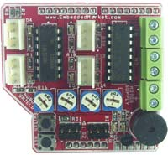
Sensor and Motor Control Shield
The board contains:
L293D Motor Driver IC
4 comparators with 4 presets for setting individual thresholds
1 Buzzer
Connectors for 2 DC Motors or 1 Stepper Motor
Connectors for 2 servo motors
Switches

Slide 86
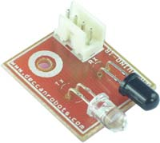
Line Sensor Infrared type
The board contains:
1 infrared emitter (dark coloured )
1 infrared detector or photodiode (colorless device)
Powered by 5V from shield

Slide 87
Motor Connections (internal) in Shield…
Motor 1:
Enable (PWM) M1_EN – D3
Direction M1_IN1 – D2
Direction M1_IN2 – D4
Motor 2:
Enable (PWM) M2_EN – D5
Direction M2_IN1 – D7
Direction M2_IN2 – D8
Buzzer buzzer – D6
Switch sw – D9

Slide 88
Motor Control Sketch
Dual_Motor_Control_Using_Shield.ino
It runs a trapezoidal speed vs time profile for
Motor 1
Motor 2
Both Motors
Note that the delay d_count decides the time period or rate of speed change

Slide 90
Infrared Emitter & Detector Testing Sketch
Open the sketch “Infrared_sensor_array”.
Connect the shield as described.
Connect 4 sensor boards to 4 connectors.
Ensure that sensor does not have any reflecting surface in front.
Adjust its pot such that its LED becomes on and then retrace it just enough to make it off. Now point sensor to a reflecting surface and see that LED becomes ON.
Run the sketch and check that sensor output level is shown on serial monitor.

Slide 91
6. TV Remote
(Infrared Receiver using RC5 Protocol for wireless control)

Slide 92
Philips RC5 Infrared Communication protocol for TV Remote
https://en.wikipedia.org/wiki/RC-5
Useful for Consumer electronics
Uses 36,38,40 KHz carrier modulation so works well in ambient sunlight
Different manufacturers may have their own protocols so we need to discover each separately.

Slide 93
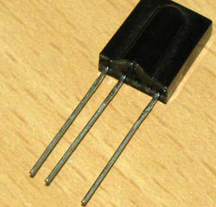
What does TSOP 173x Receiver Do?
3-terminal intelligent receiver
works on 5V and GND
select 1738 or 1736 for 38 KHz or 36 KHz demodulator
contains PIN diode, pre-amplifier, band-pass filter and automatic gain control
generates pulses received from TV remote

Slide 94
What does TV Remote do?
It contains a small controller which:
Detects key pressed and encodes it in 14-bit or longer code
The codes are modulated on a carrier frequency of 36,38 or 40 KHz and code bits are serially shifted out us on a IR emitter LED. You can see IR emitter glowing when viewed through a mobile camera.

Slide 95
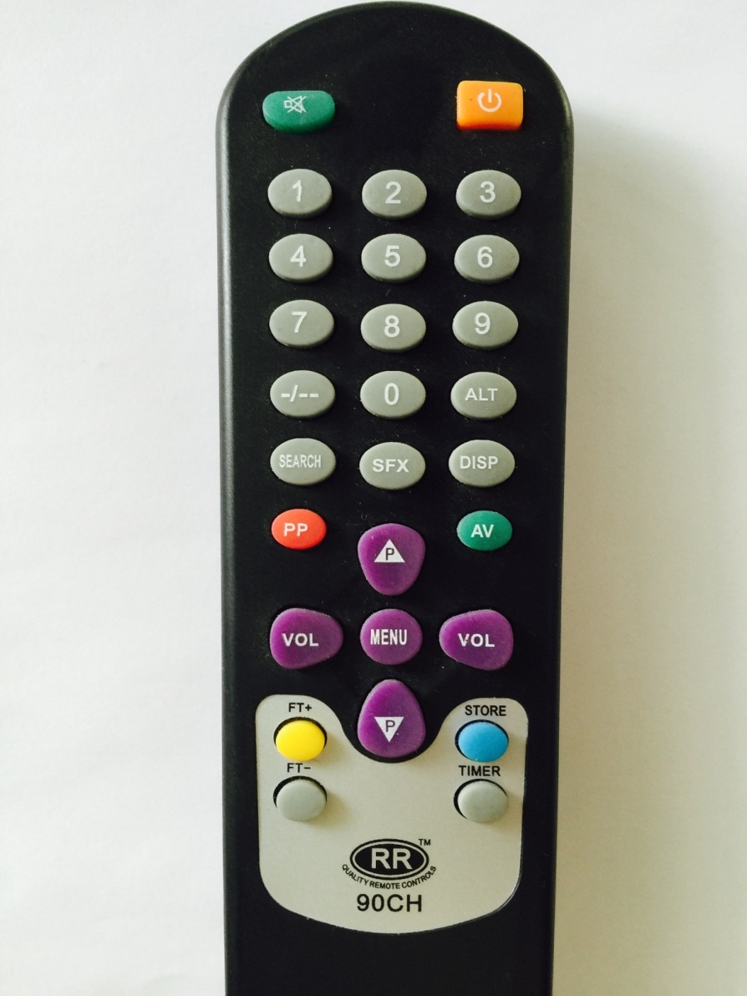
Codes generated by few keys
Keys 0 to 9 - Code 0 to 9
Channel + - Code 0x20
Channel - - Code 0x21
Volume+ - Code 0x10
Volume- - Code 0x11
MENU - Code 0x3B
DISP - Code 0x0F
PP - Code 0x0E
ALT - Code 0x22
AV - Code 0x38
SFX - Code 0x24
SEARCH - Code 0x1E
STORE - Code 0x29

Slide 96
Test your TV Remote
Use sketch “my_first_RC5_code.ino”
Press each key and check its code.
Note that one key action may result in 2-3 codes being generated of same value
You can squelch these by inserting a 500 to 1000 ms delay in receiving function
Some codes have 0x800 added to it. So we detect and subtract to normalize.

Slide 97
Practical Use of TV remote- Home Automation?
Use sketch “TV_Remote_IRrecvdemo_demo_with_LCD.ino”
Press each key and check its code.
Note that P+ and P- keys affect Led selected and VOL+ and Vol- keys affect intesity of selected LED.
Check that LCD display shows the Led selected and intensity of all 3 LEDs as a PWM number between 0 to 255 in steps of 255.

Slide 98
7. Sensor Reading
(Temperature & Light parameter measurement and signal processing)

Slide 99
Review

Slide 100
Au Revoir
Please note this is only a beginning!
I wish you all wonderful experiences and accomplishments ahead with Arduino hardware and software…..

